Slide 2




How to use Azure Document Intelligence for OCR in RAG Solutions
Samuel Bamgbola
Gold Student Ambassador
Saturday 29th March, 2025
5PM
WAT
https://bit.ly/AzureOCR-for-RAG-live

Slide 3
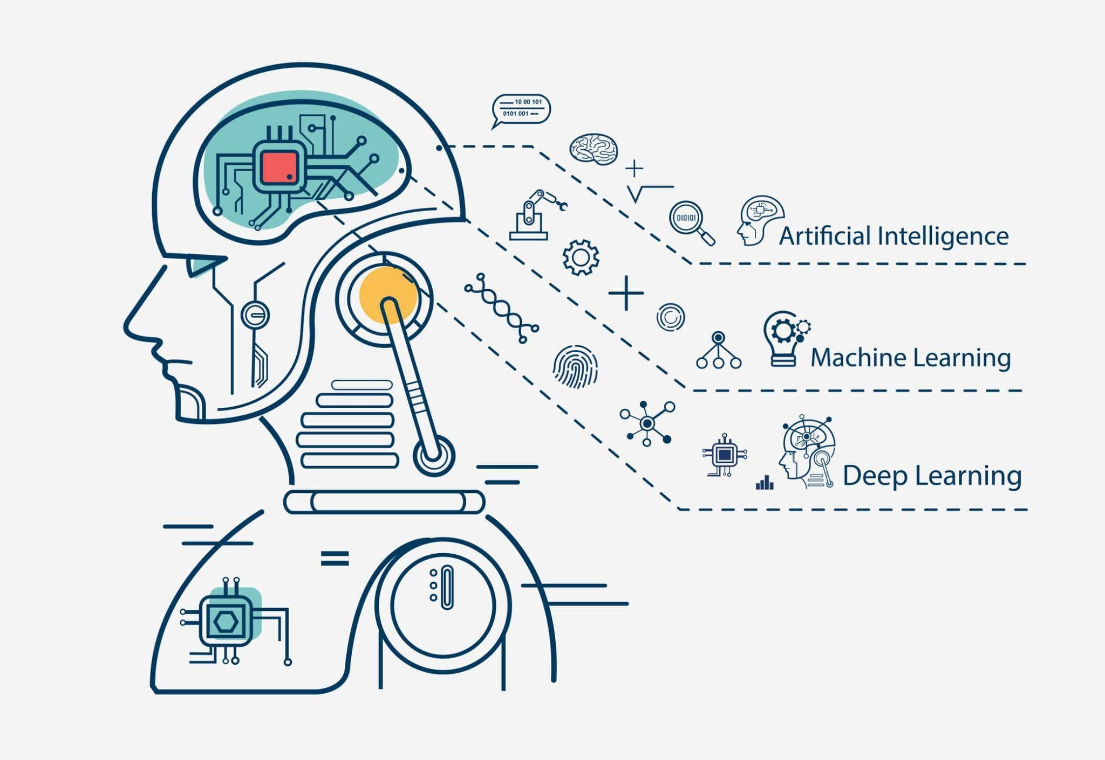
WHAT IS AI?
Artificial Intelligence (AI) refers to computer systems designed to perform tasks that typically require human intelligence, such as learning, problem-solving, and decision-making.

Slide 4
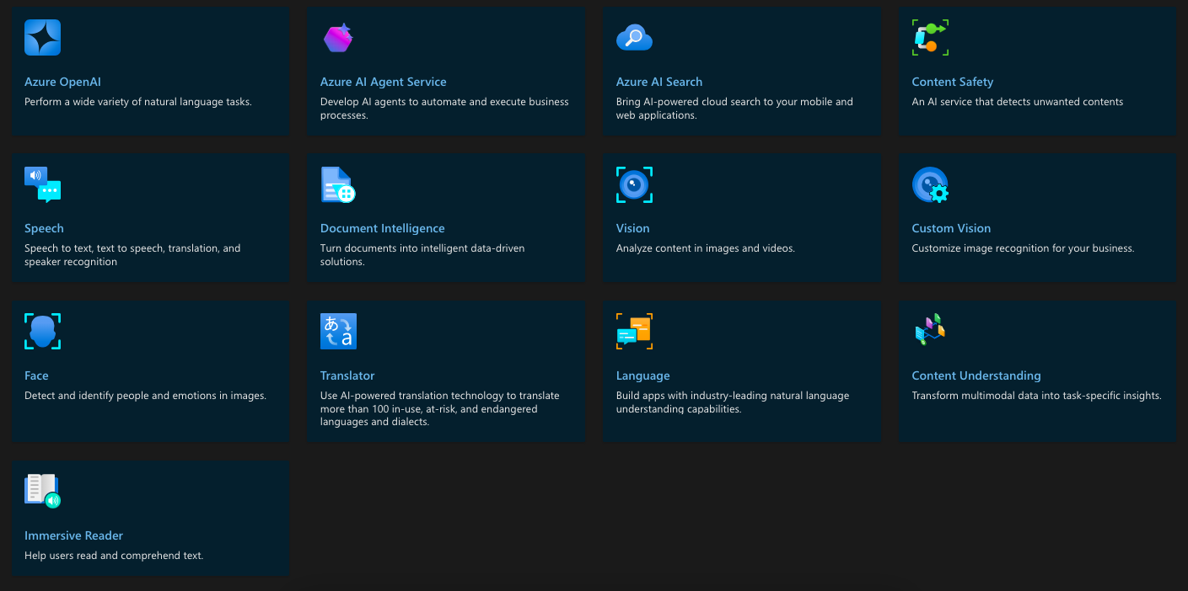
WHAT ARE AZURE AI SERVICES?
Azure AI services are cloud-based AI services that help developers and organizations rapidly create intelligent, cutting-edge, market-ready, and responsible applications with out-of-the-box and pre-built and customizable APIs and models.

Slide 5
OCR & RAG

Slide 6
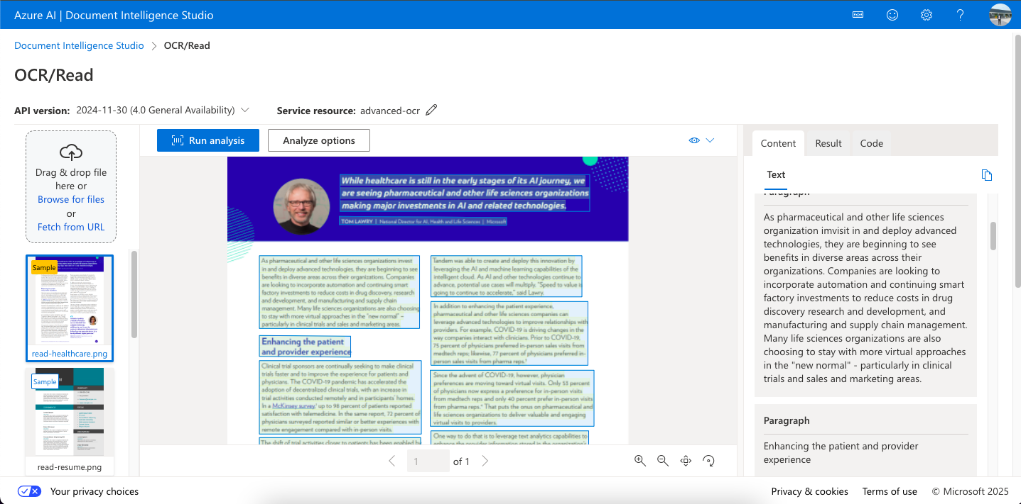

Slide 7
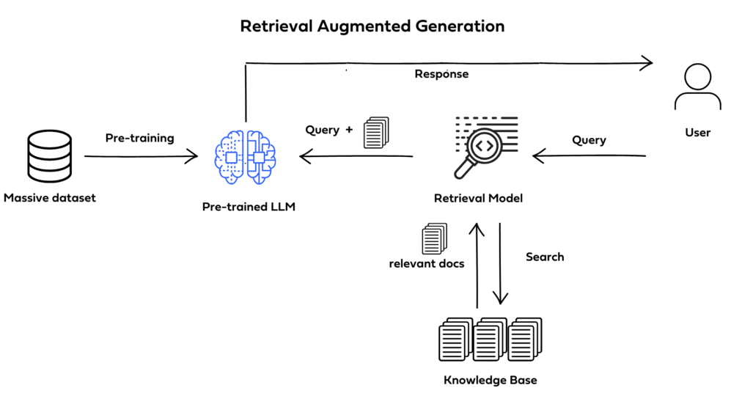

Slide 8
LEARNING PATHS/RESOURCES TO EXPLORE
Develop solutions with Azure AI Document Intelligence
Azure AI Document Intelligence Documentation
Retrieval-Augmented Generation with Azure AI Document Intelligence

Slide 9
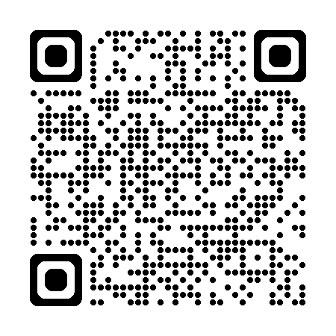
Take our two-question survey
Notes:
https://go.microsoft.com/fwlink/?linkid=2271366

Slide 10
THANK YOU

